Slide 1
QUB_ARES Doorbell Hacking Session 3

Slide 2
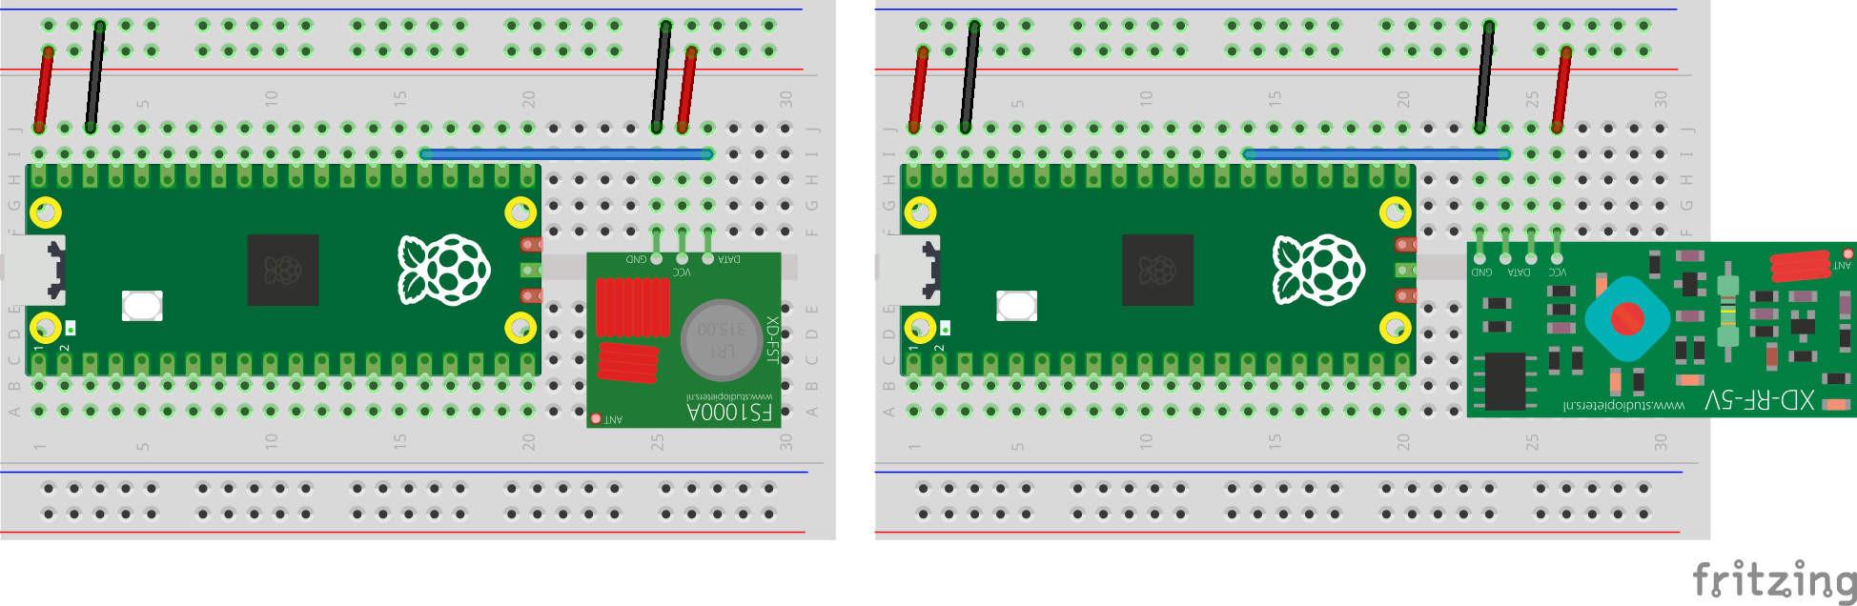
Transmitter (TX)
Receiver (RX)

Slide 3


Slide 4
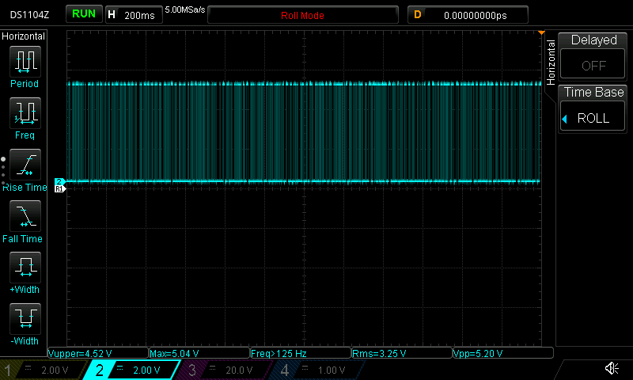

Slide 5
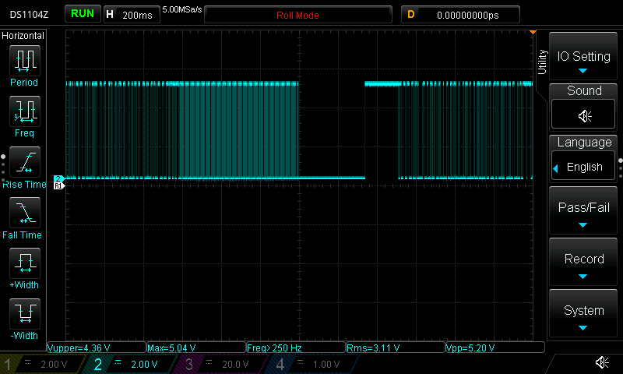
doorbell
pressed
doorbell
released

Slide 6
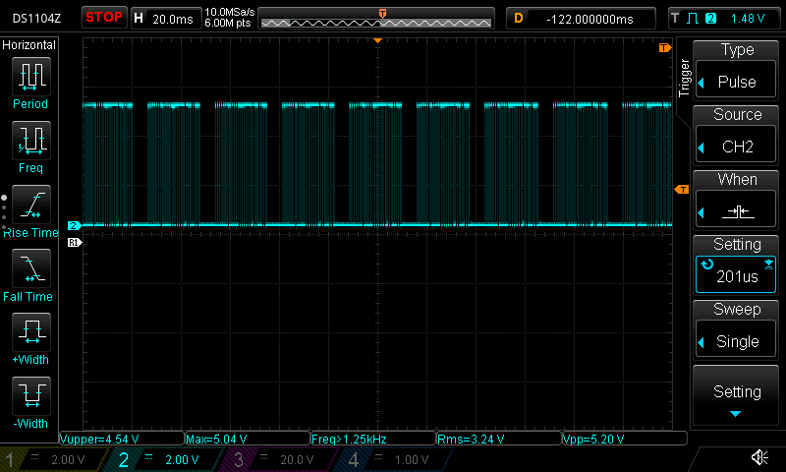

Slide 7
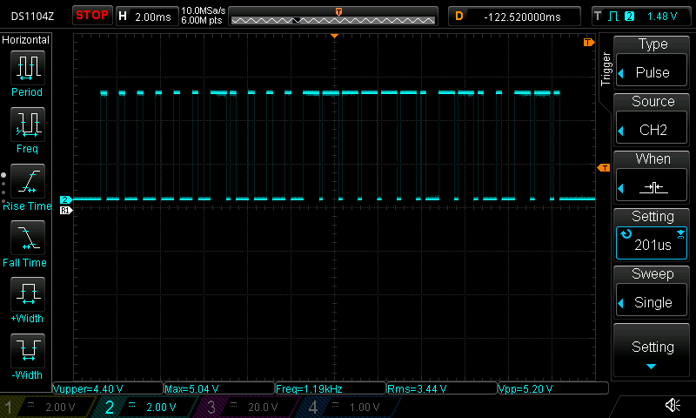

Slide 9


Slide 10
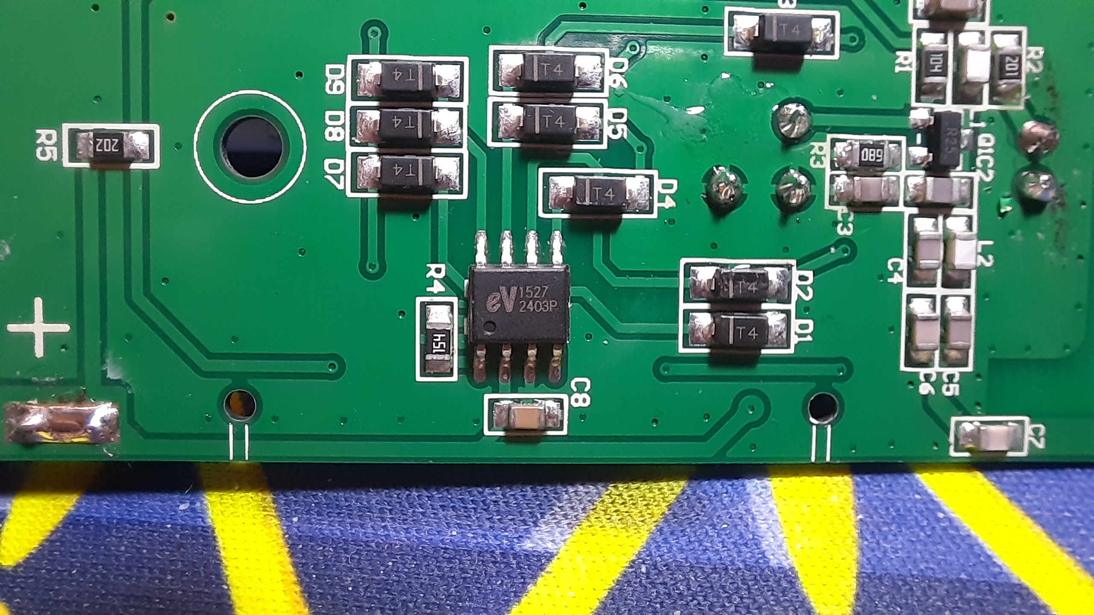

Slide 11
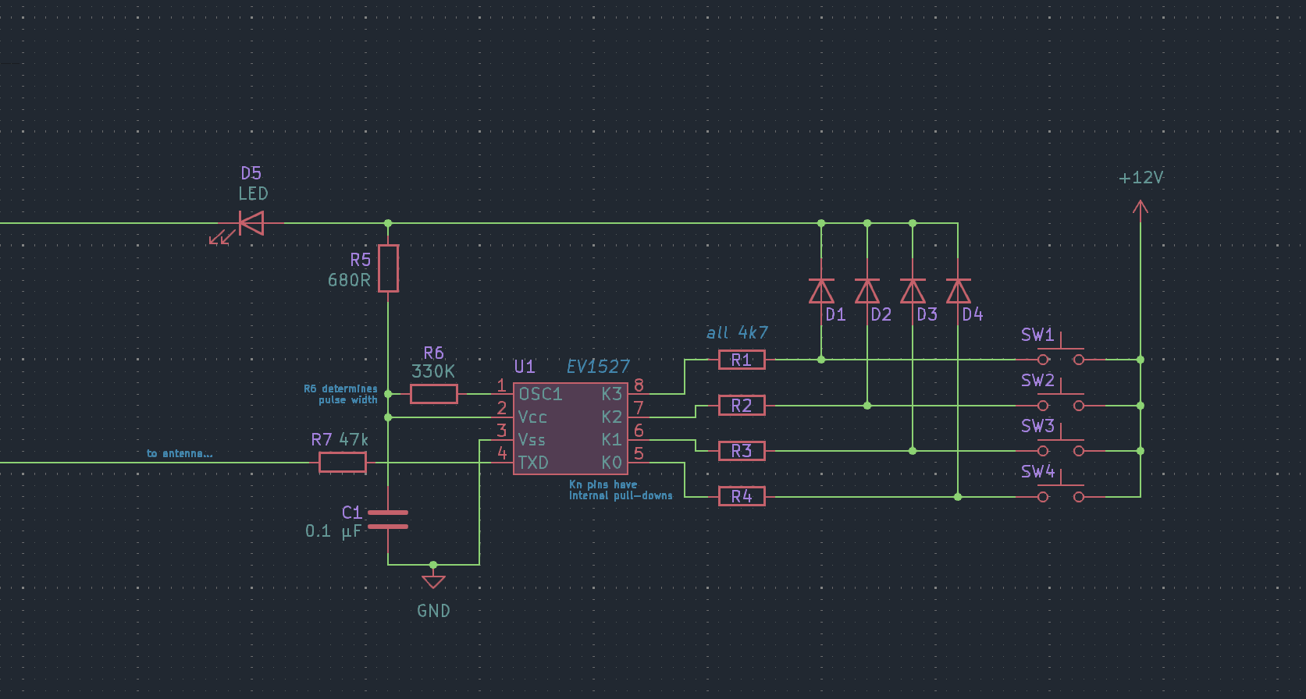

Slide 12
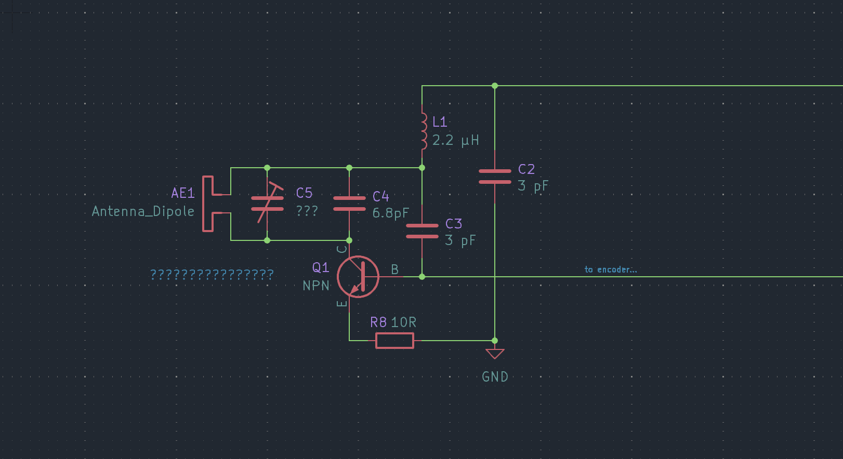

Slide 13
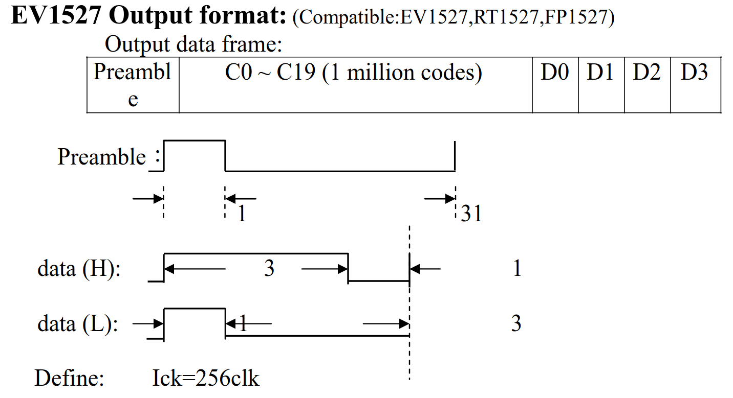

Slide 14
1 part high
31 parts low
3 parts high, 1 part low
1 part high, 3 parts low

Slide 15
long pulses are high
short pulses are low

Slide 16
MSB
0
0
0
0
0
0
1
0
0
0
0
1
1
1
1
1
1
0
1
1
0
0
1
1
0
LSB
13918710

Slide 18
???????????????????????
MSB
0
0
0
0
0
0
1
0
0
0
0
1
1
1
1
1
1
0
1
1
0
0
1
1
0
LSB

